Slide 1


A rad Application Platform
Introducing
@PalmEmanuel
Notes:
Intro – story about containers, modernization, new skills and cognitive load
Raise of hands – Who’s a developer? Who would like to spend less time needing to learn and write templates for Kubernetes, ARM or other IaC, or at least simplify it?

Slide 2
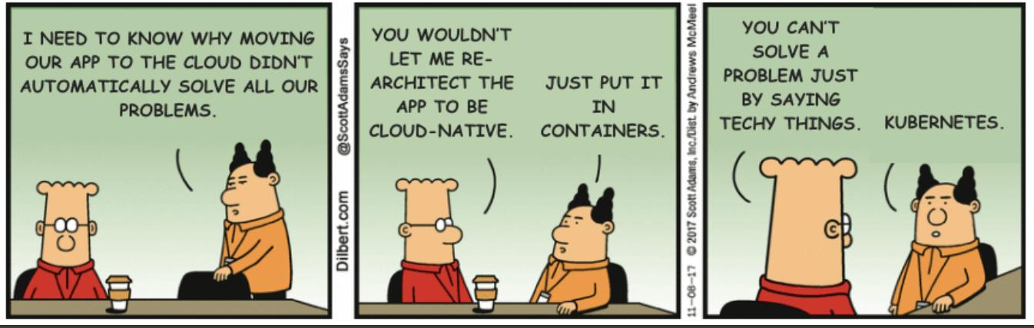

Slide 3

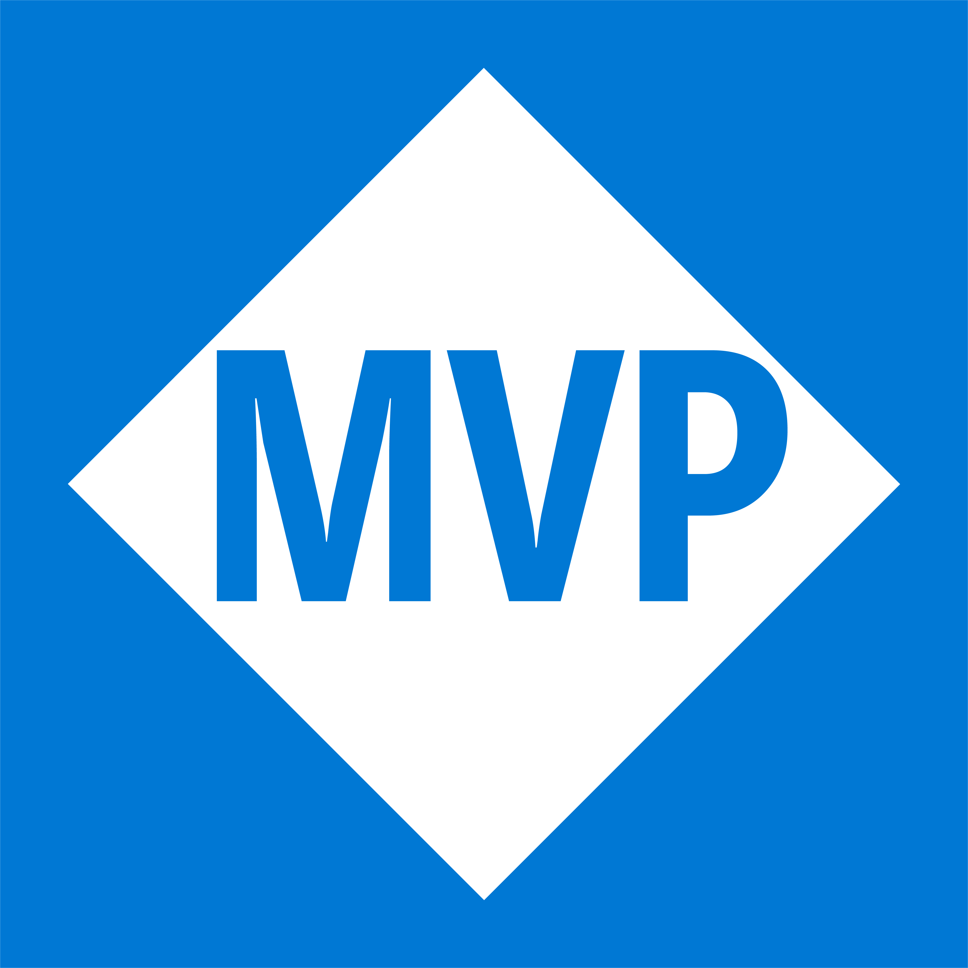
Emanuel Palm
@PalmEmanuel
🧙☕🍰🧗🥏
❤️ Everything-as-Code
📦 Makes modules & tools
📃 Fan of Open Source
☁️ Blogs at pipe.how

Slide 4




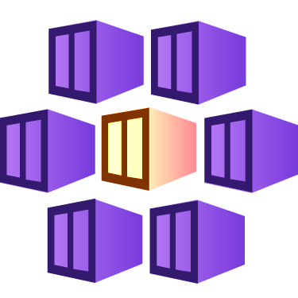








Your App
Key Vault
Kubernetes (AKS)
Storage
Function
Managed Identity
Notes:
Raise of hands
Is this your application?
No. Kubernetes is not your application.
Is this your application?
Maybe. It has components, identities and integrations outside wherever it resides.

Slide 5


Session Overview
1
2
3
Radius?
Demo
Summary & Questions

Slide 6
Radius was created to…
… create a common understanding of what an application is
for Developers
for Platform Engineers
for IT Operators
for Security Experts
… support developers
on Kubernetes
on Serverless Platforms in the future
… by integrating with existing workflows and tooling
like Bicep
like Terraform
like Helm charts
like Kubernetes YAML

Slide 7
Appi-ness
the feeling of satisfaction one has when the application is at the center of every workflow

Slide 8
≠
Remote Authentication Dial-In User Service (RADIUS)

Slide 9

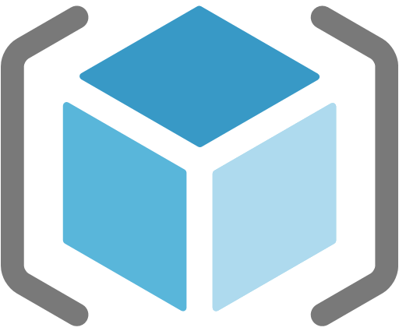
Azure Resource Manager (ARM)
Bicep
Radius

Slide 10


Notes:
Pretty humerus, you could say

Slide 11
Notes:
Pretty humerus, you could say

Slide 12





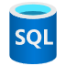
Application
Internet
Gateway
Frontend
Container
Backend
Container
Redis
Cache
SQL
Database

Slide 13



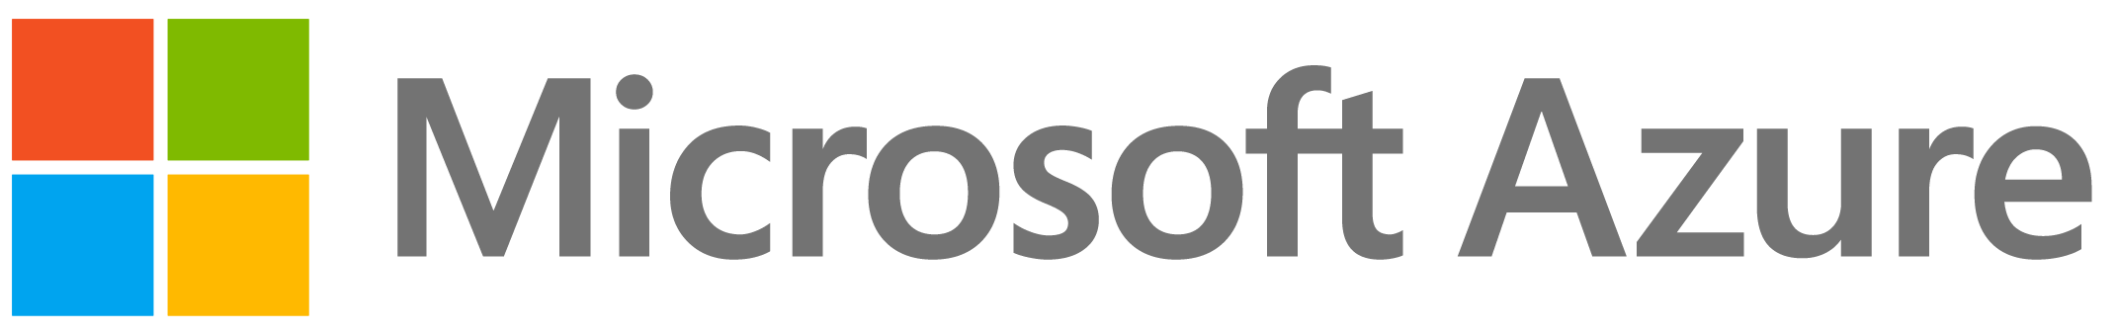
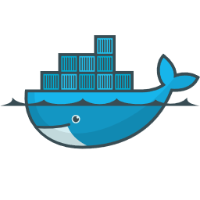
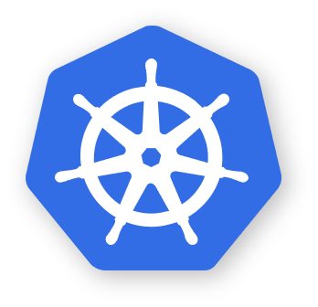
Environment
RECIPES
Azure Cache
for Redis
Azure
SQL DB
COMPUTE
Azure
Kubernetes Service
Application
Environment
Internet
Gateway
RECIPES
Redis
Container
SQL
Container
Frontend
Container
Local development
Backend
Container
Redis
Cache
COMPUTE
CNCF-certified
Kubernetes
SQL
Database

Slide 14

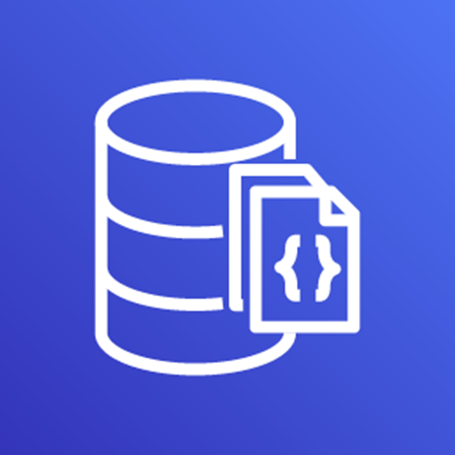


Environment
RECIPES
AWS
MemoryDB
AWS
DocumentDB
COMPUTE
Elastic
Kubernetes Service
Application
Environment
Internet
Gateway
RECIPES
Azure Cache
for Redis
Azure
SQL DB
Frontend
Container
Backend
Container
Redis
Cache
COMPUTE
Azure
Kubernetes Service
SQL
Database
Environment
RECIPES
Redis
Container
SQL
Container
Local development
COMPUTE
CNCF-certified
Kubernetes

Slide 15
Application
Environment
Internet
Gateway
RECIPES
AWS
MemoryDB
AWS
DocumentDB
Frontend
Container
Backend
Container
Redis
Cache
COMPUTE
Elastic
Kubernetes Service
SQL
Database
Environment
RECIPES
Azure Cache
for Redis
Azure
SQL DB
COMPUTE
Azure
Kubernetes Service

Slide 16
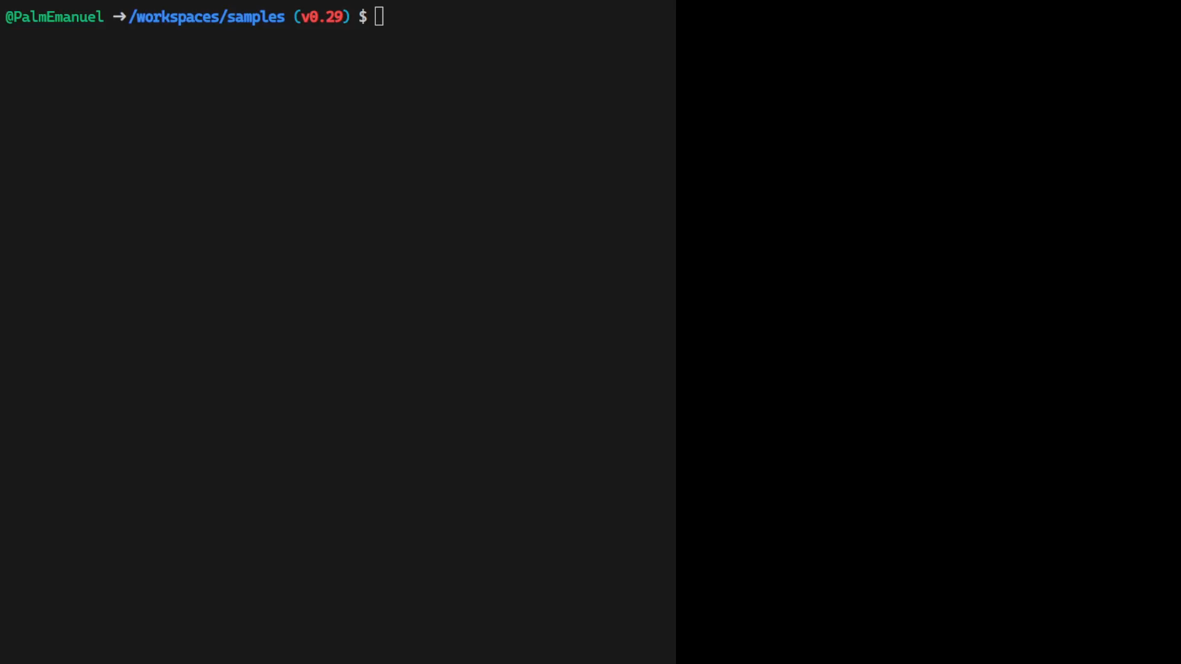
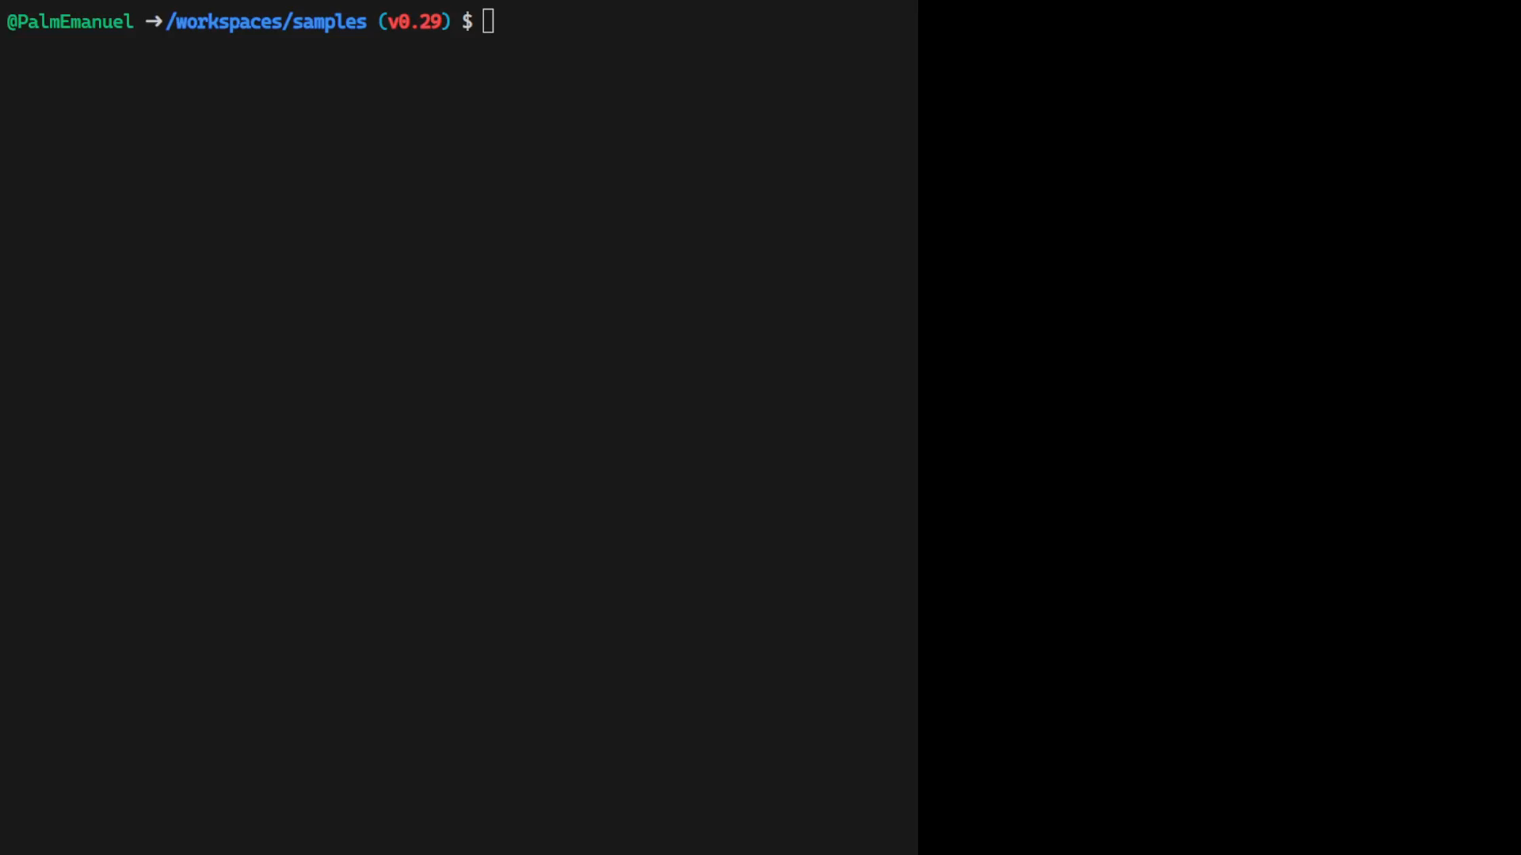
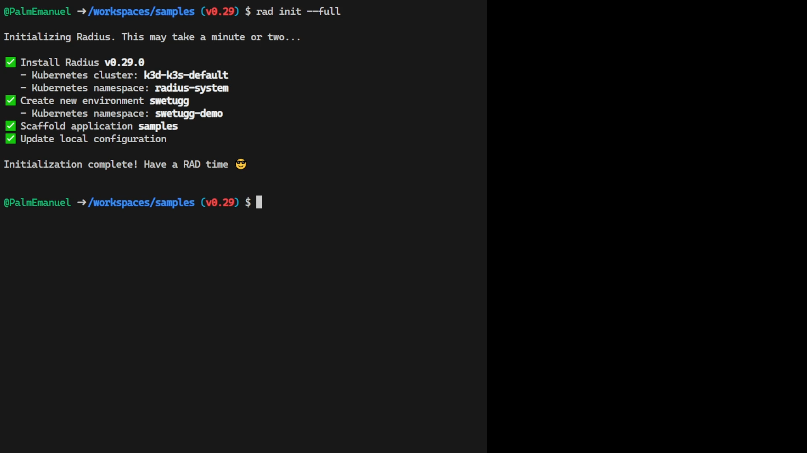



default (workspace)
swetugg
demo
swetugg (group)
Internet
Gateway
Frontend
Container
Backend
Container
Redis
Container
SQL
Container
Notes:
Side-by-side
Code animation/video | Diagram of Radius components

Slide 17













Bicep for Radius
Notes:
Even AWS through the AWS Cloud Control API
Custom fork at the moment (with special VS Code extension)
Show a recipe file
“Wow that’s cool, I can deploy Bicep to AWS. Does that mean I need to also allow my cluster to speak to ARM, and that Microsoft built a bunch of Azure Resource Providers for AWS? No, Radius has forked Bicep and implemented some new cool stuff which makes it possible to compile the Radius Bicep templates to something that deploys directly to AWS Cloud Control API

Slide 18
Where does Radius fit into your organization?
Last section of "Concept: Why Radius": "Developers and platform engineers need to collaborate". Explaining how the different parts of Radius fits into an organization with roles like platform engineers, operators, cloud and security experts, developers.
If your developers want cake, but your organization has an allergy against public access, you can create a recipe to ensure private networking.
In platform engineering, Microsoft talks about paving paths for your organization to make it easier to follow requirements and policies, Recipes can be a way to achieve that
Use it with an example where you hard-code some public access part of a recipe, but allow parameters for something else

Slide 19
Notes
There is a codespace to get started, or a bunch of alternatives for installation
News since release (0.28 or 0.29 for example) – show dashboard
There’s a roadmap
Currently you can only manage the cluster Radius is installed in, but multi-cluster support is planned
Mention DAPR integration

Slide 20
rad init
Notes:
Show codespace from VS Code
The anatomy of a template and Recipe
There’s a special VS Code extension (while they fork Bicep)
Deploying to both local environment and Azure
Dashboard sneak peek

Slide 21



Summary (thanks Slidemania)
Radify your apps now
It’s well-documented and open source, there’s a roadmap and there are monthly community calls.
Promote Appi-ness
Implement tools that allow you to speak the same language in the organization, communication is always 🔑
3
example
radapp.io
aka.ms/radius/discord
github.com/radius-project

Slide 22
Questions
How does Radius compare to X?
https://docs.radapp.io/concepts/faq/#comparison-to-other-tools

Slide 23
Very interesting facts!
This is where you section ends. Duplicate this set of slides as many times you need to go over all your sections.

Slide 24
Thank you!
Do you have any questions?
hello@mail.com
555-111-222
mydomain.com

